Slide 1
ITM - Xamarin introduction Juan Carlos Zuluaga Email: jzuluaga55@gmail.com Phone: 350 634 2747 Twitter: jzuluga55@hotmail.com Youtube: jzuluaga55

Slide 2
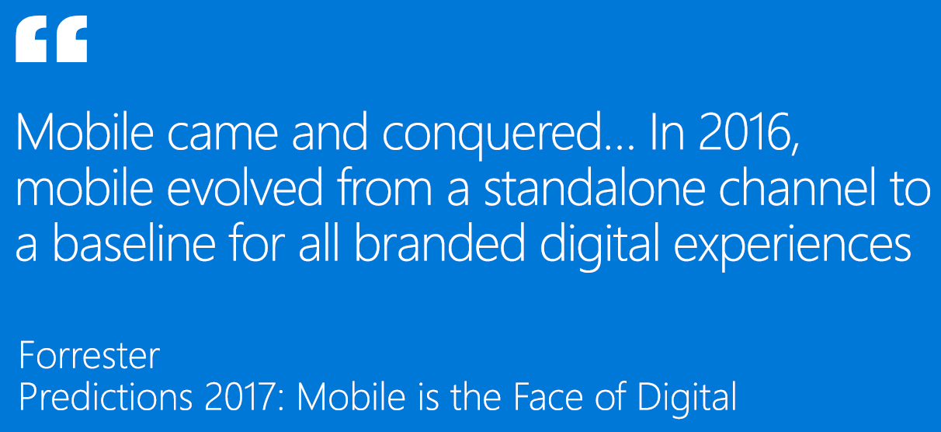
Is important Mobile?

Slide 3
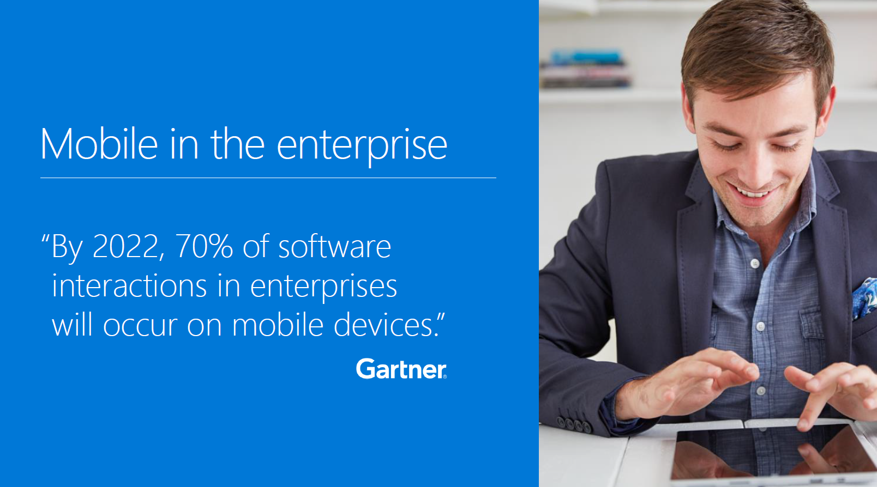
Is important Mobile?

Slide 4
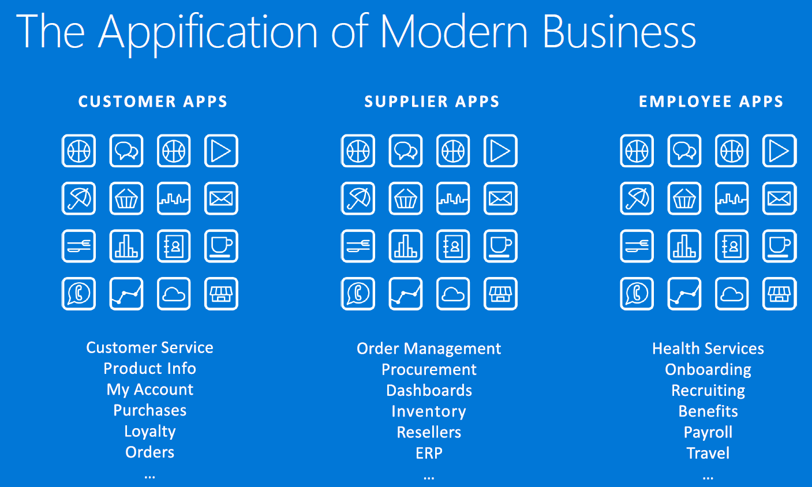
The Appification

Slide 5
Appification Challenge #1
Demand
(5 x)
Develop

Slide 6
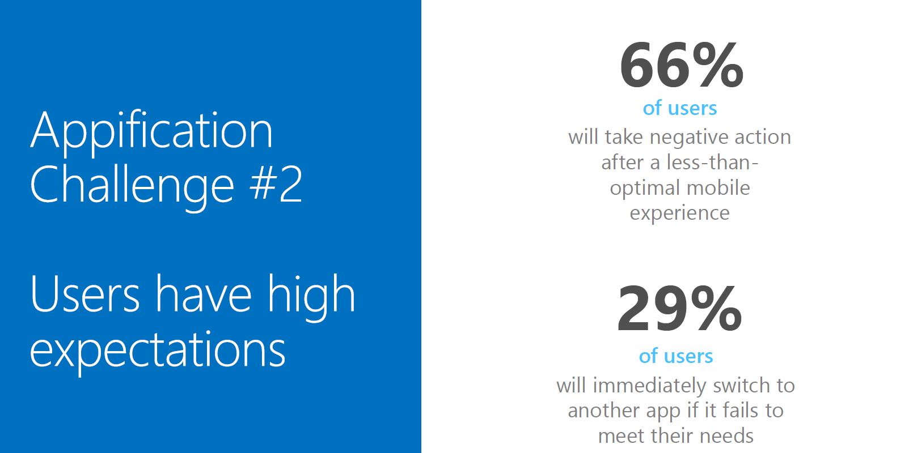
Appification Challenge #2

Slide 7
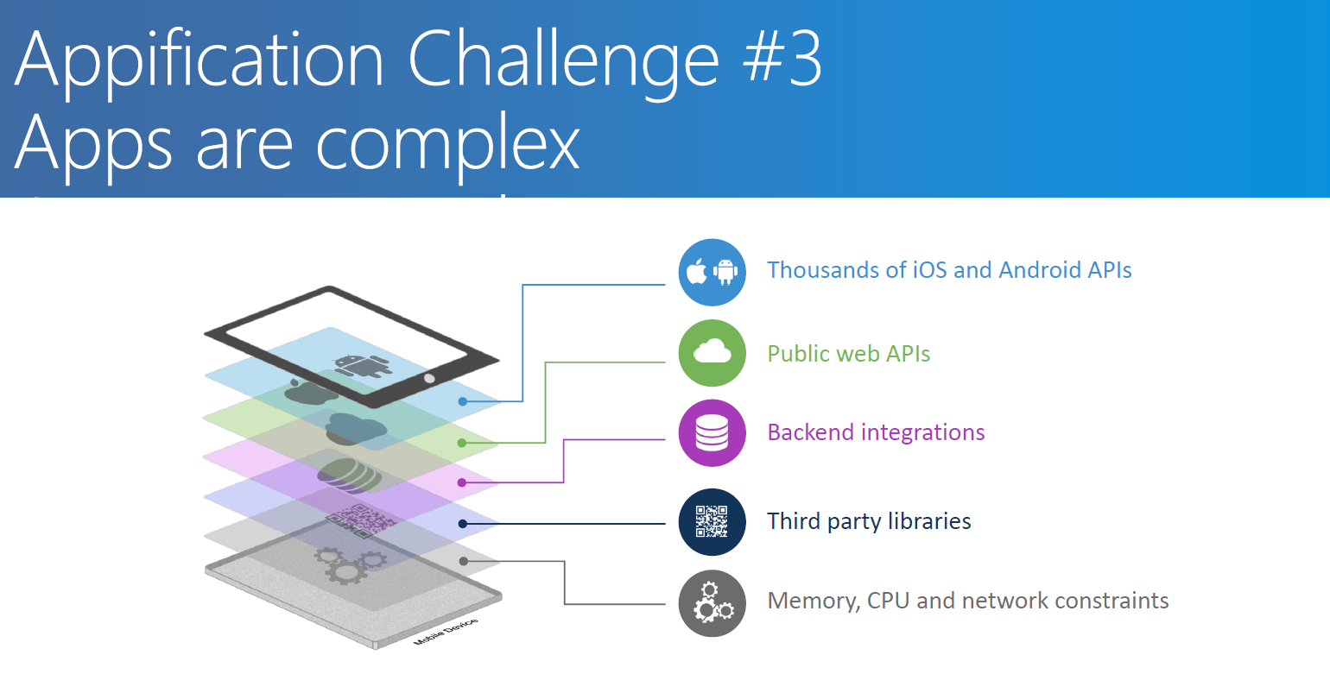
Appification Challenge #3

Slide 8
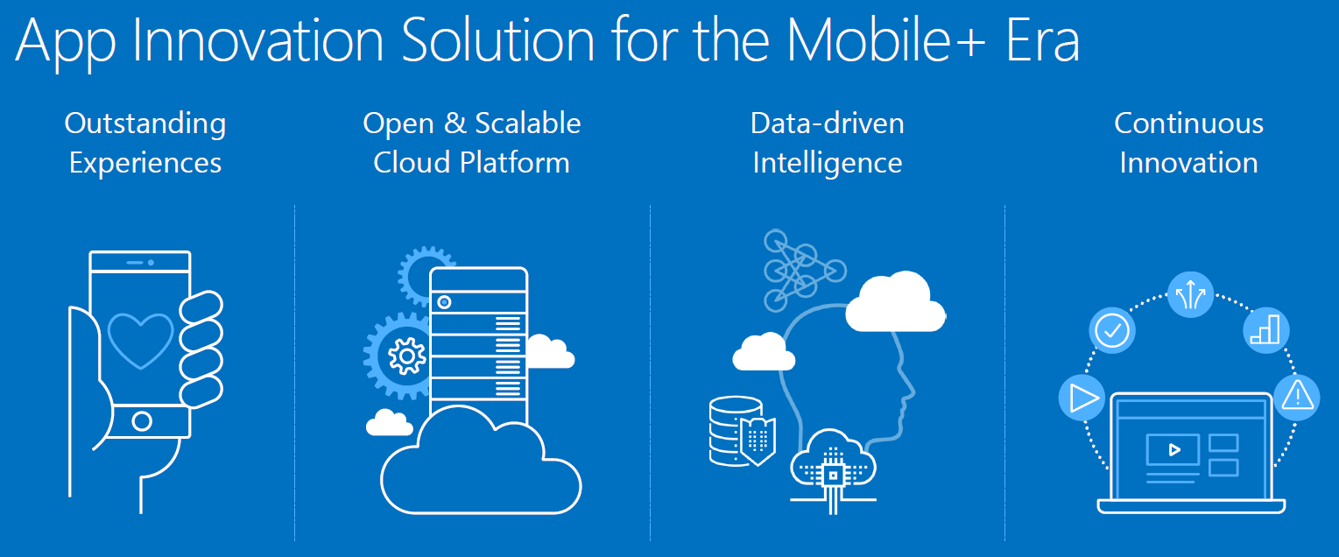
Mobile Lifecycle

Slide 9
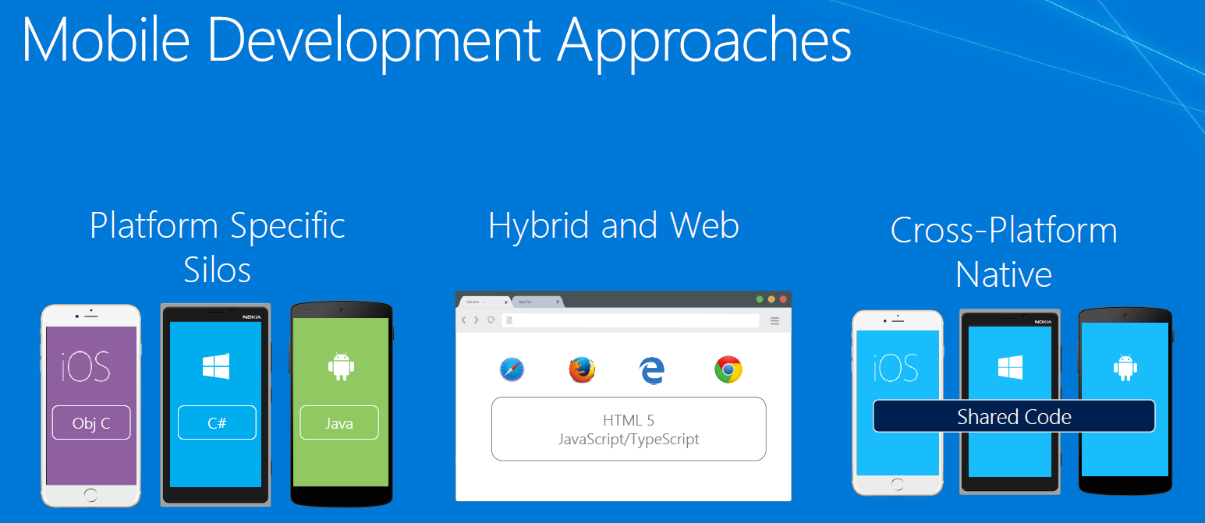
My ways?

Slide 10
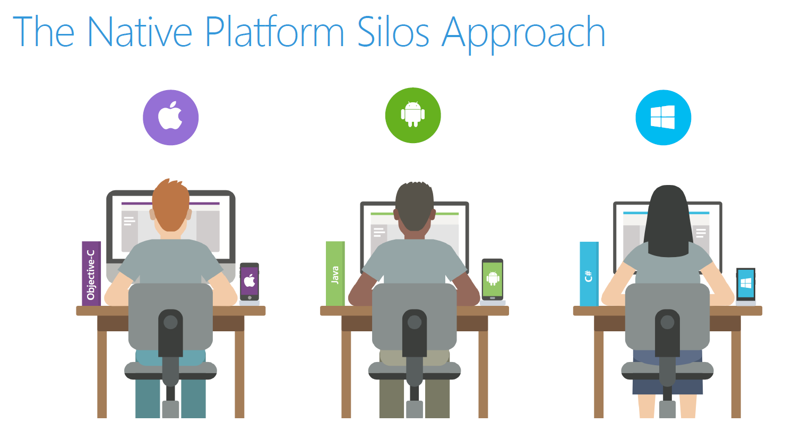
Native

Slide 11
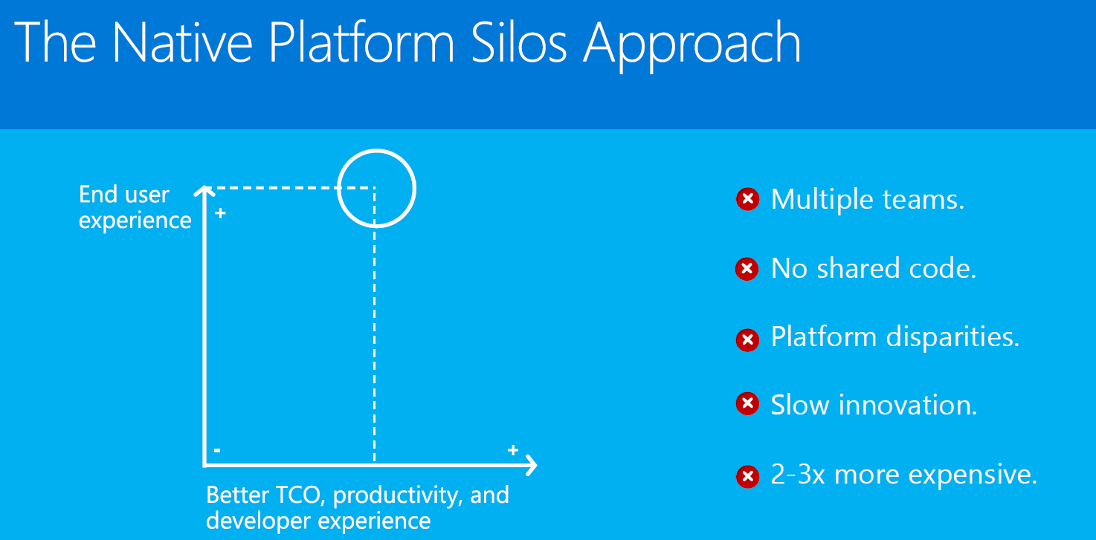
Native approach

Slide 12
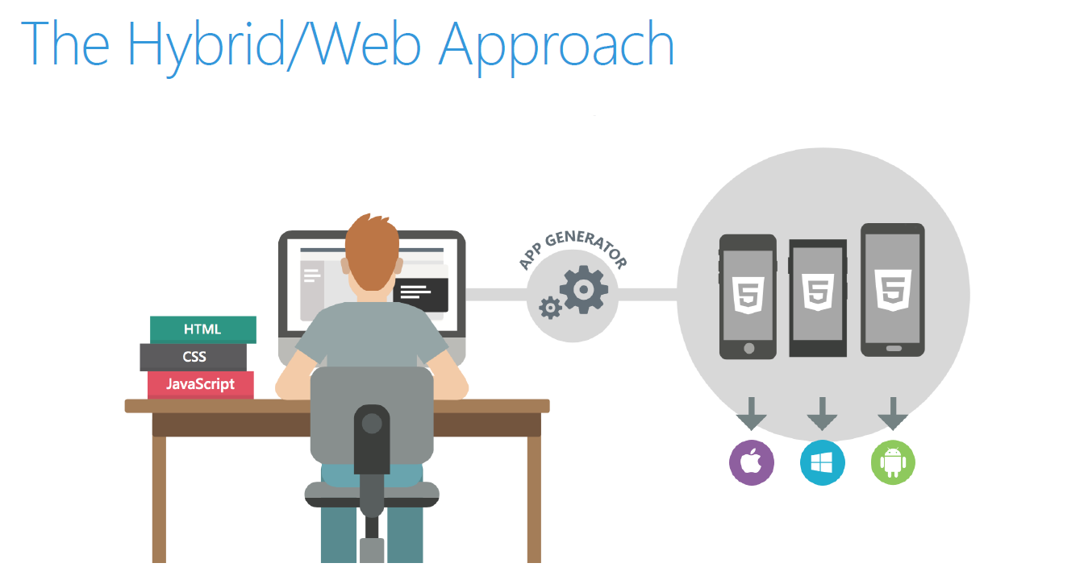
Hybrid

Slide 13
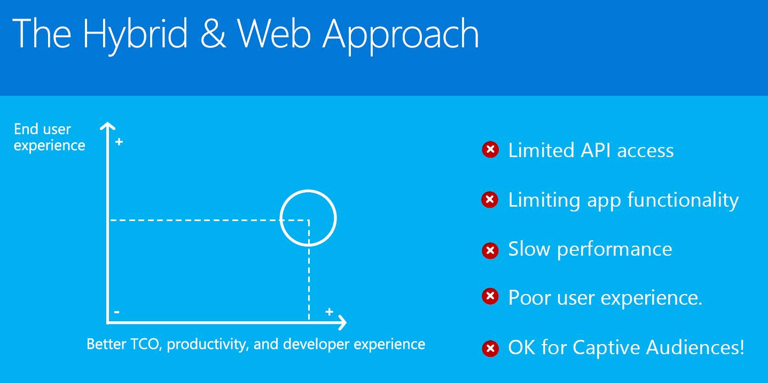
Hybrid Approach

Slide 14
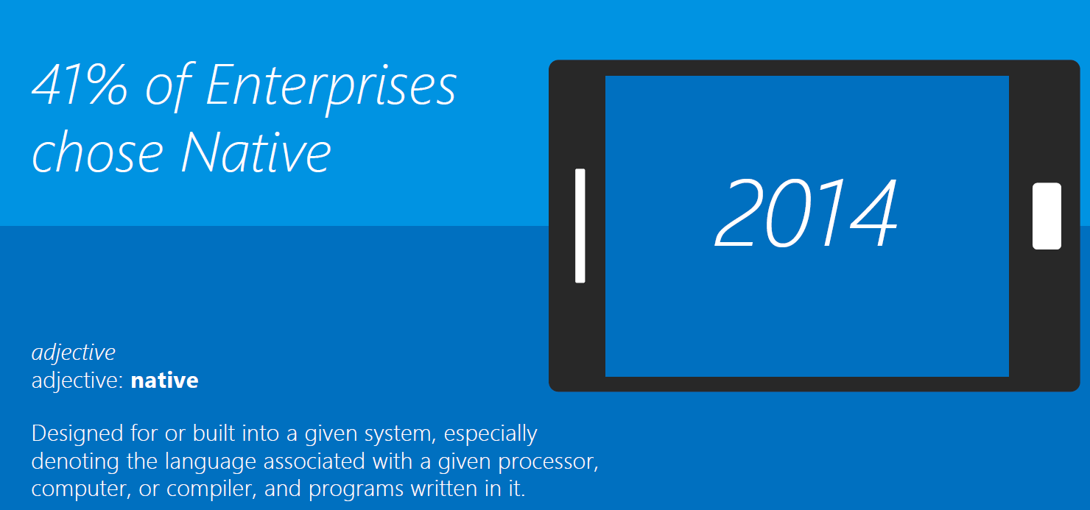
Why is native important?

Slide 15
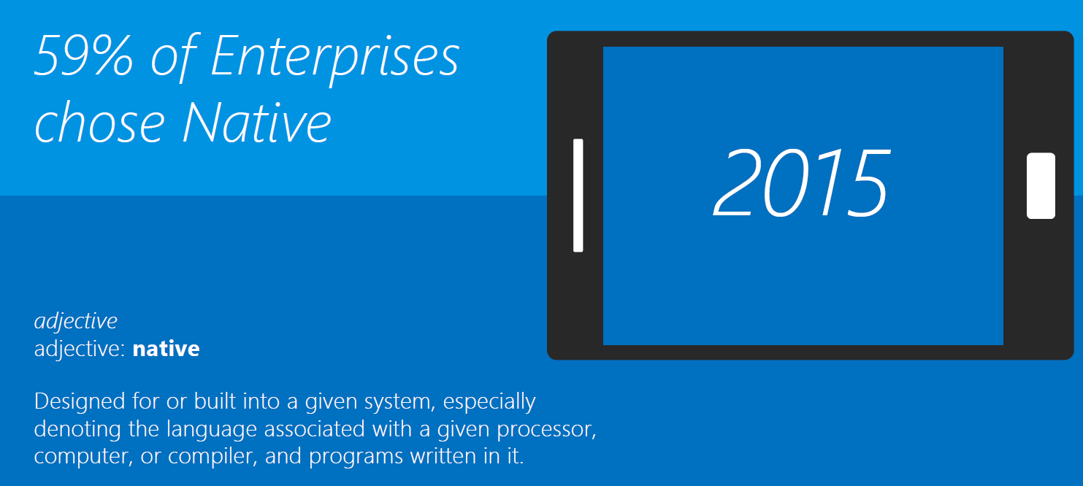
Why is native important?

Slide 16
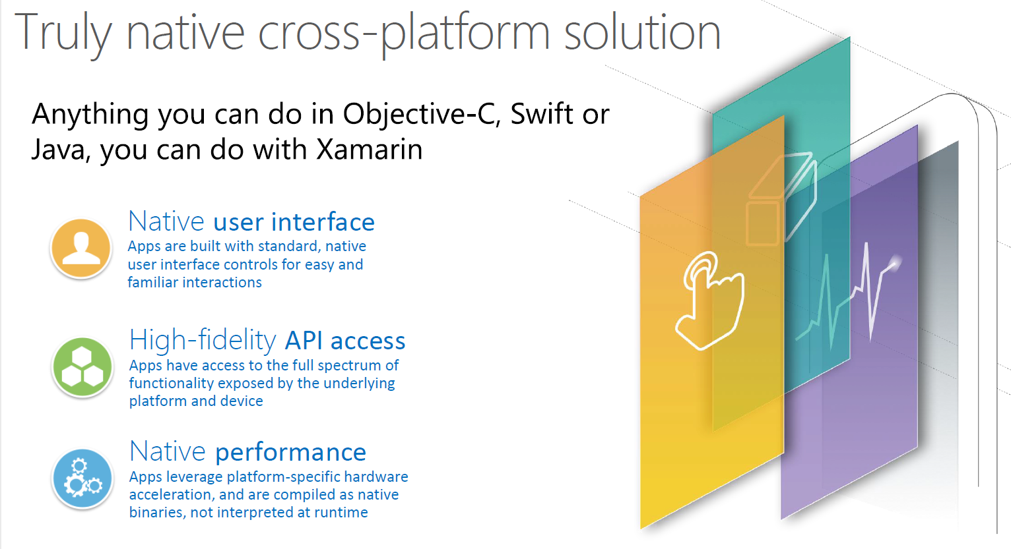
Xamarin = Truly native

Slide 17
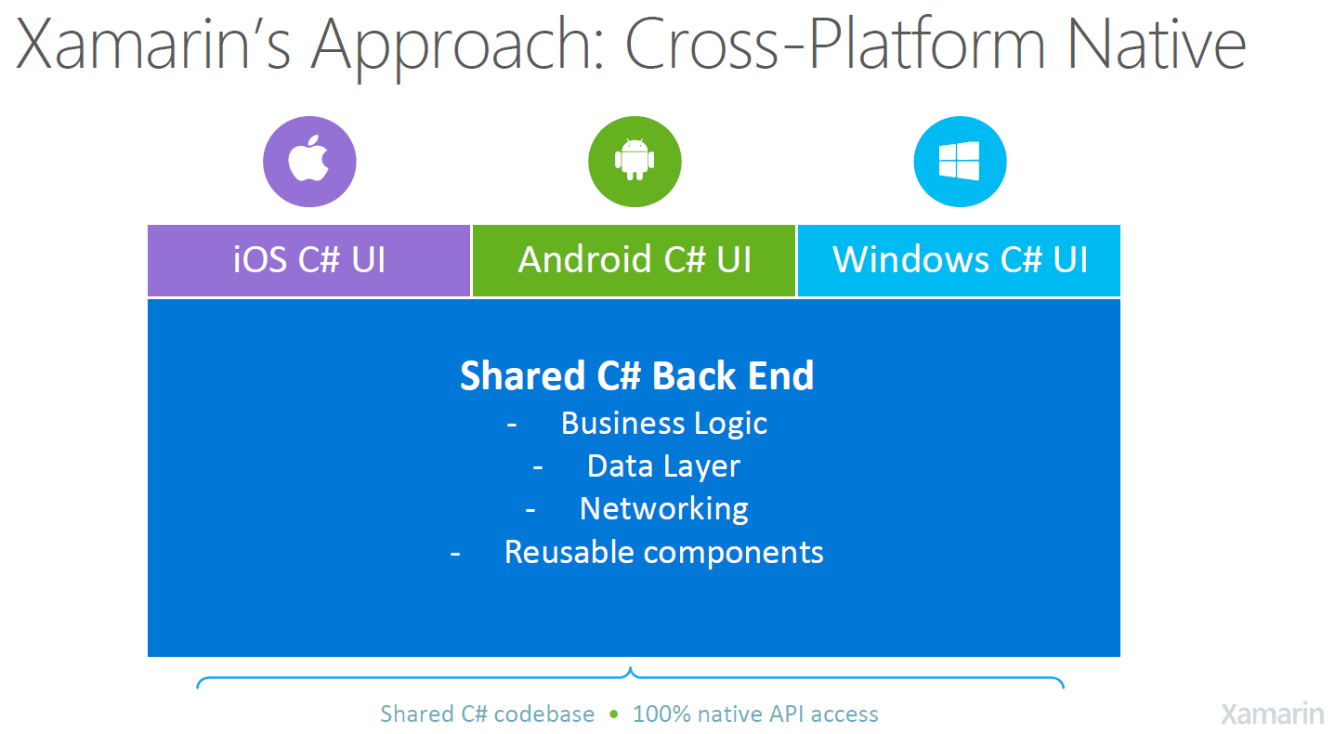
Xamarin = Share

Slide 18
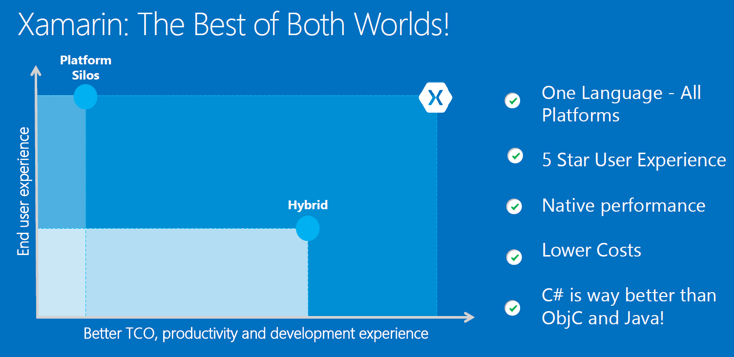
Xamarin = mix of best practices

Slide 19
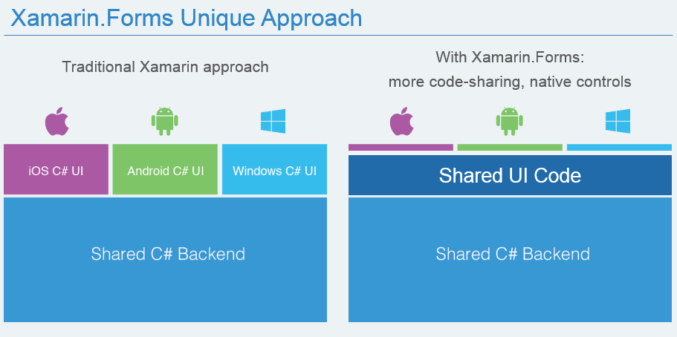
Xamarin Vs Xamarin Forms

Slide 20
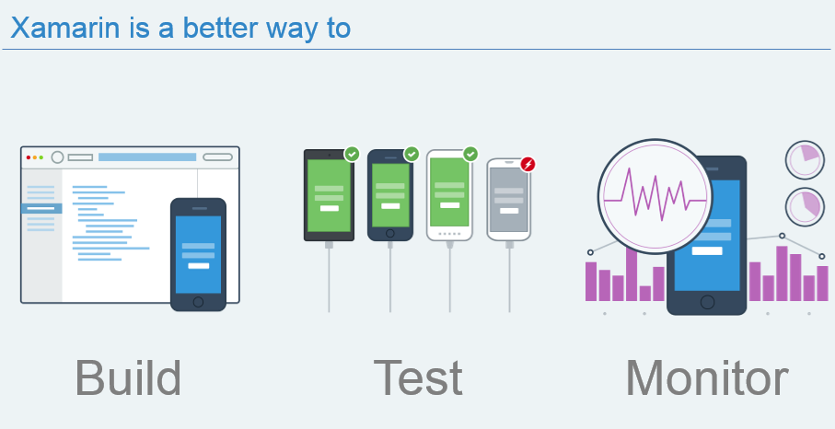
Xamarin is not only to develop

Slide 21
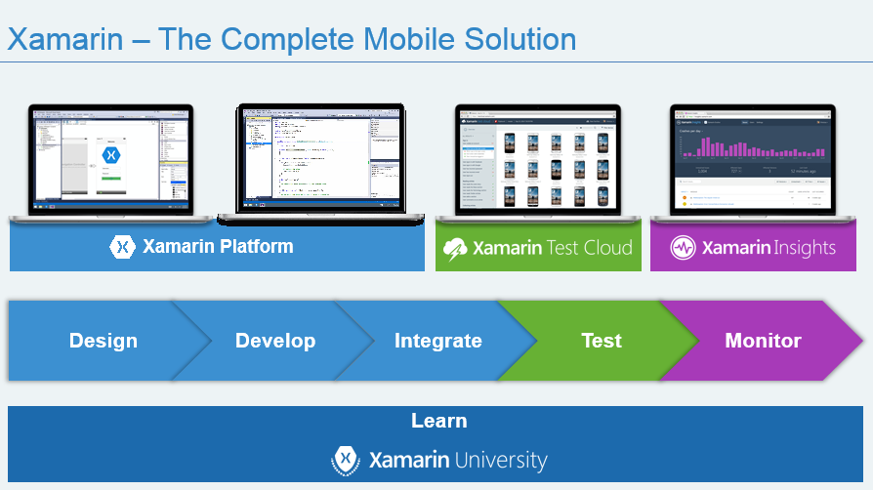
Xamarin complete suit

Slide 22
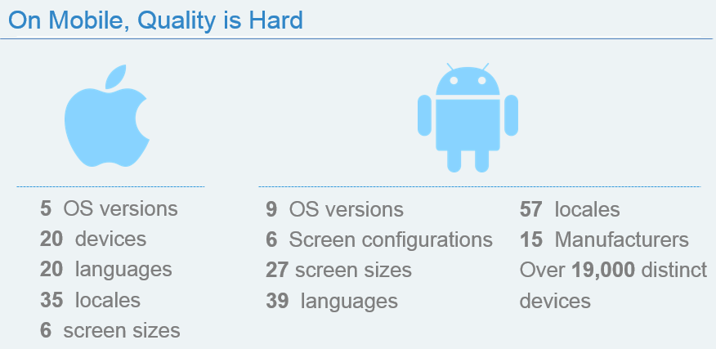
Mobile complexity

Slide 23
Demo

Slide 24
THANK YOU

